Slide 1
Procedural Modeling of Roads
By Kaiwen Yu

Slide 2

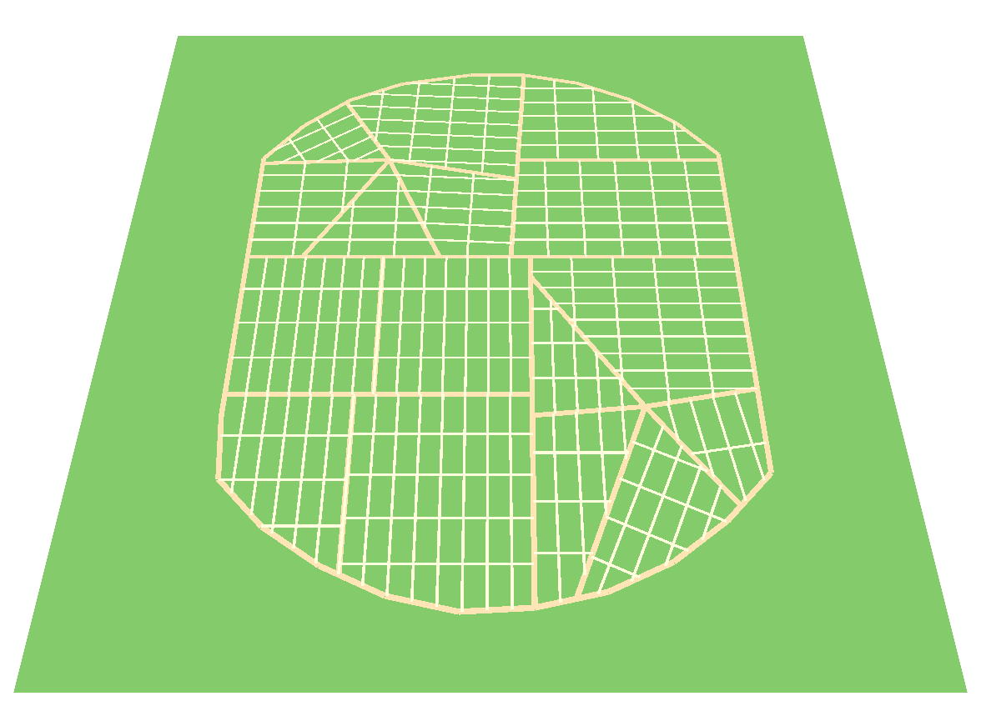
Sample input output

Slide 3
purpose
Help design and plan urban roads. Also may help design road patterns in virtual worlds like games.

Slide 4
Previous work
Procedural Modeling of Cities
Yoav I H Parish, Pascal Müller
Example-Driven Procedural Urban Roads
G. Nishida, I. Garcia-Dorado, and D. Aliaga

Slide 5
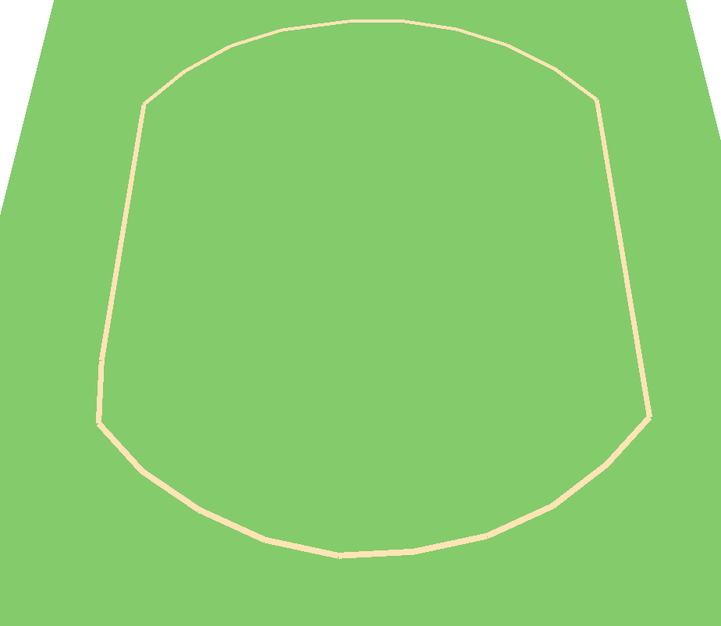
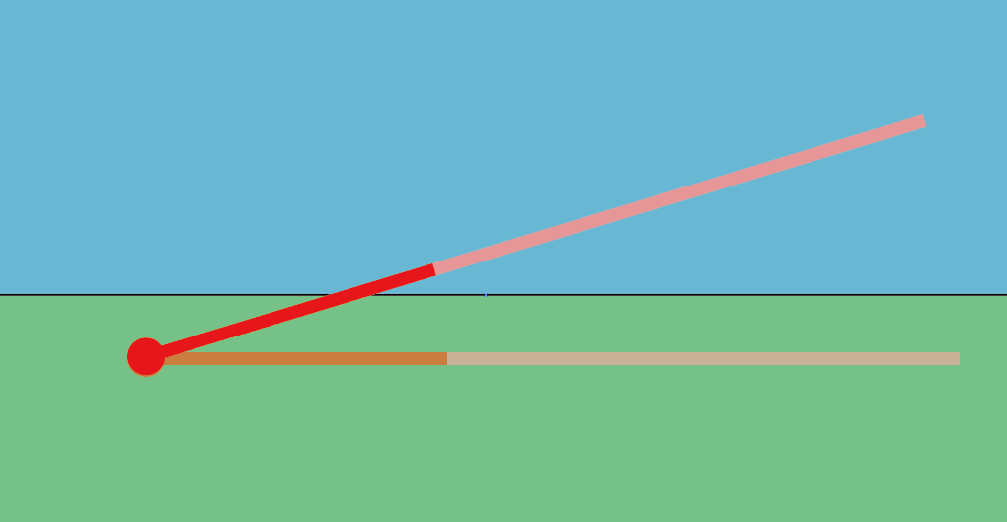
Step1-Generate outer loop

Slide 6
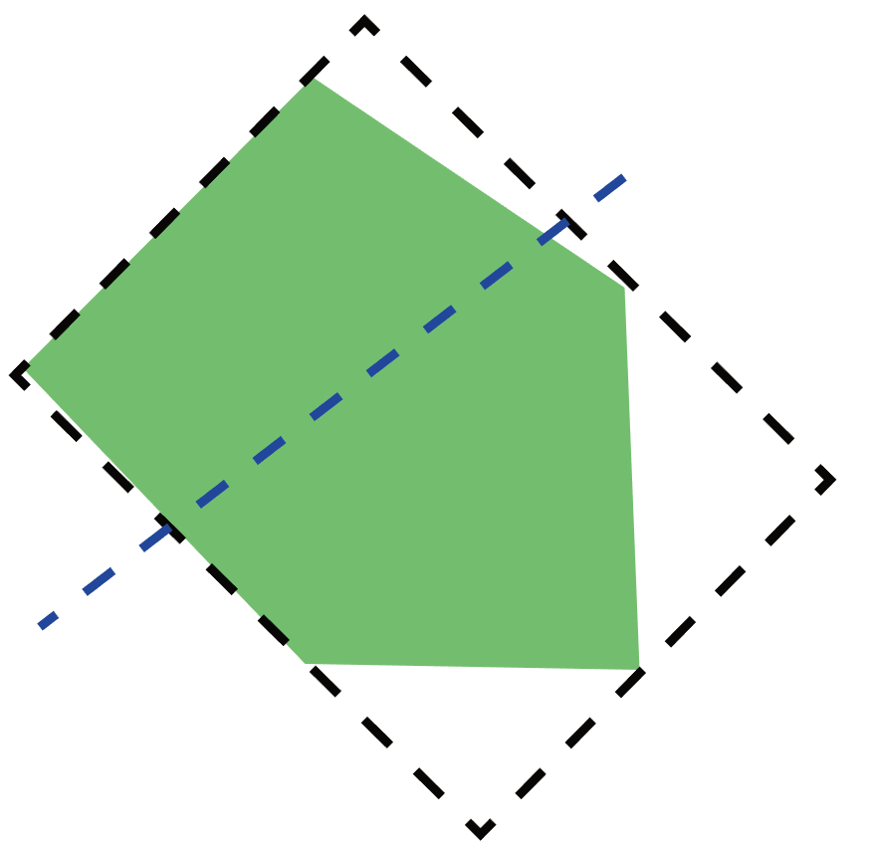
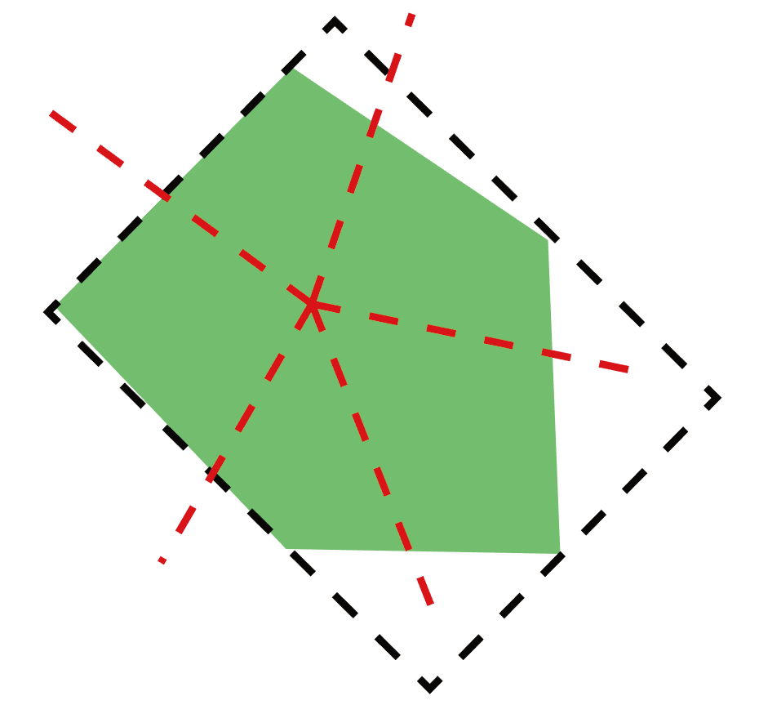
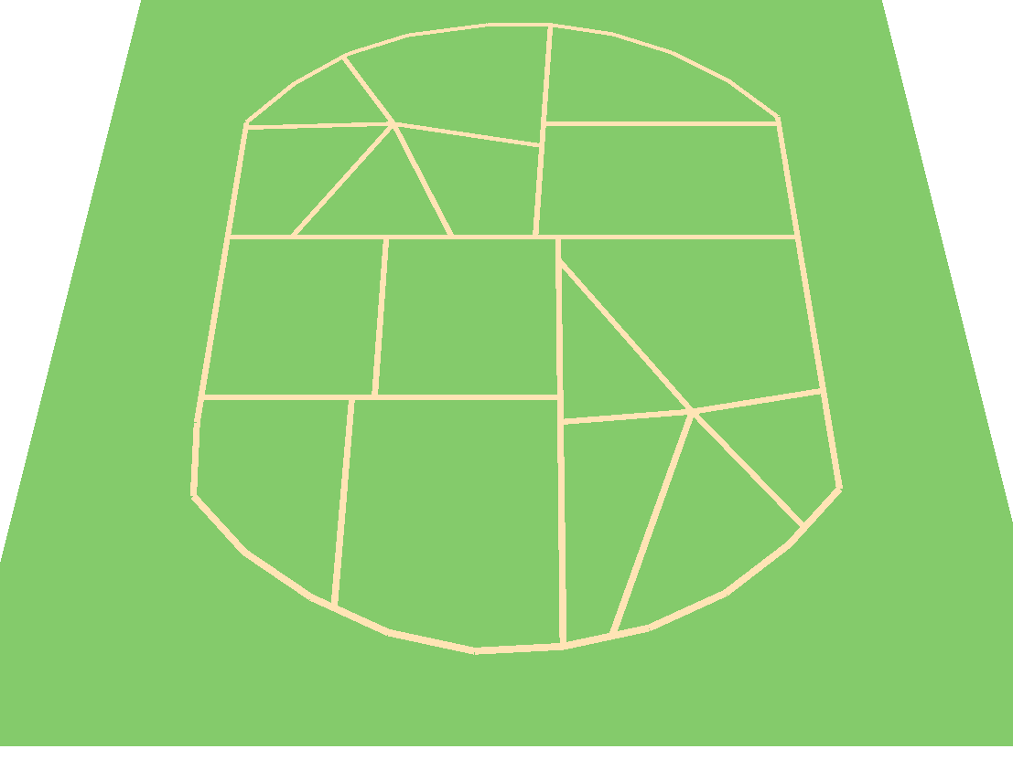
Step2-generate Large area

Slide 7
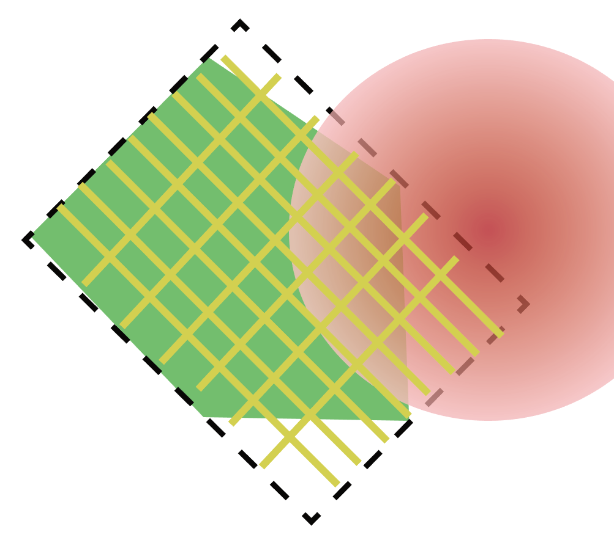
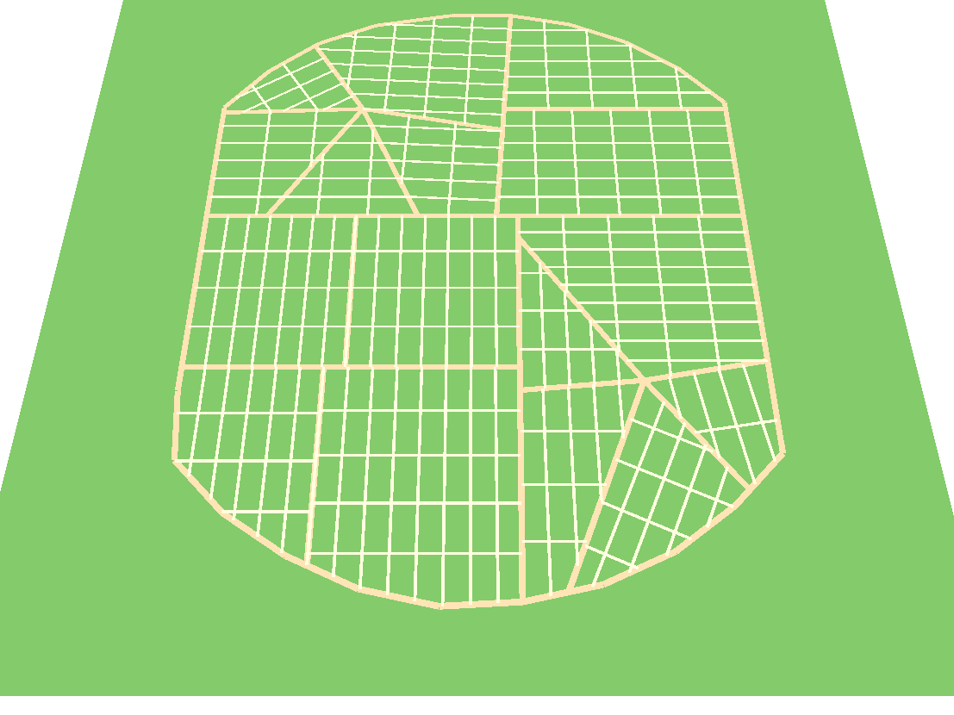
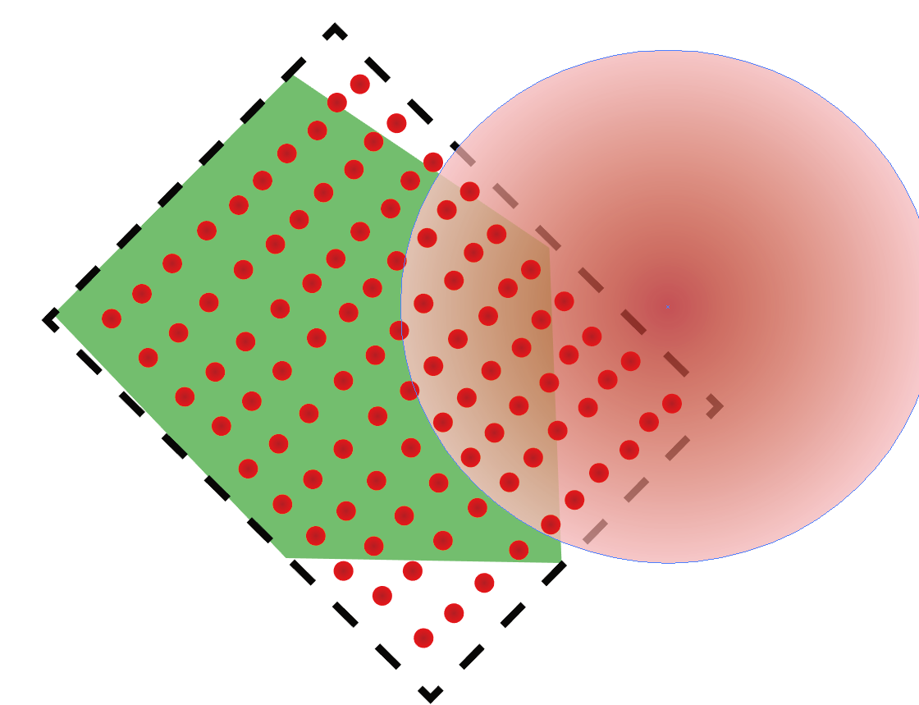
Step3-Generate grid

Slide 8
Demos

Slide 9
Future Improvement
Image parsing
More patterns

Slide 10
Questions

Slide 11
Reference
PARISH Y. I. H., MÜLLER P.: Procedural modeling of cities. In ACM SIGGRAPH 2001 (2001), ACM Press.

